Slide 1

Homebrew Long-Baseline Interferometry (LBI) for Education and research
Stephen Wang, Canyon Crest Academy
Shengwang Du, University of Texas, Dallas
Notes:
Hello Everyone, my name is Stephen Wang, I am currently a senior student enrolled in Canyon Crest Academy.
I am here to present a Homebrew Long-Baseline Interferometry device for education and research.

Slide 2

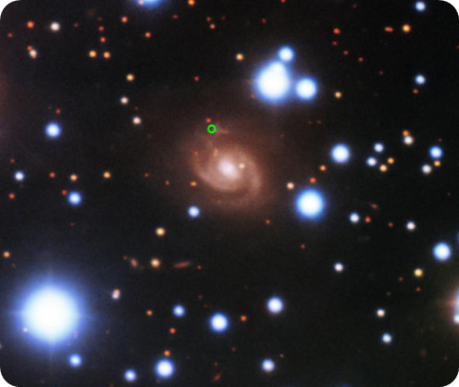
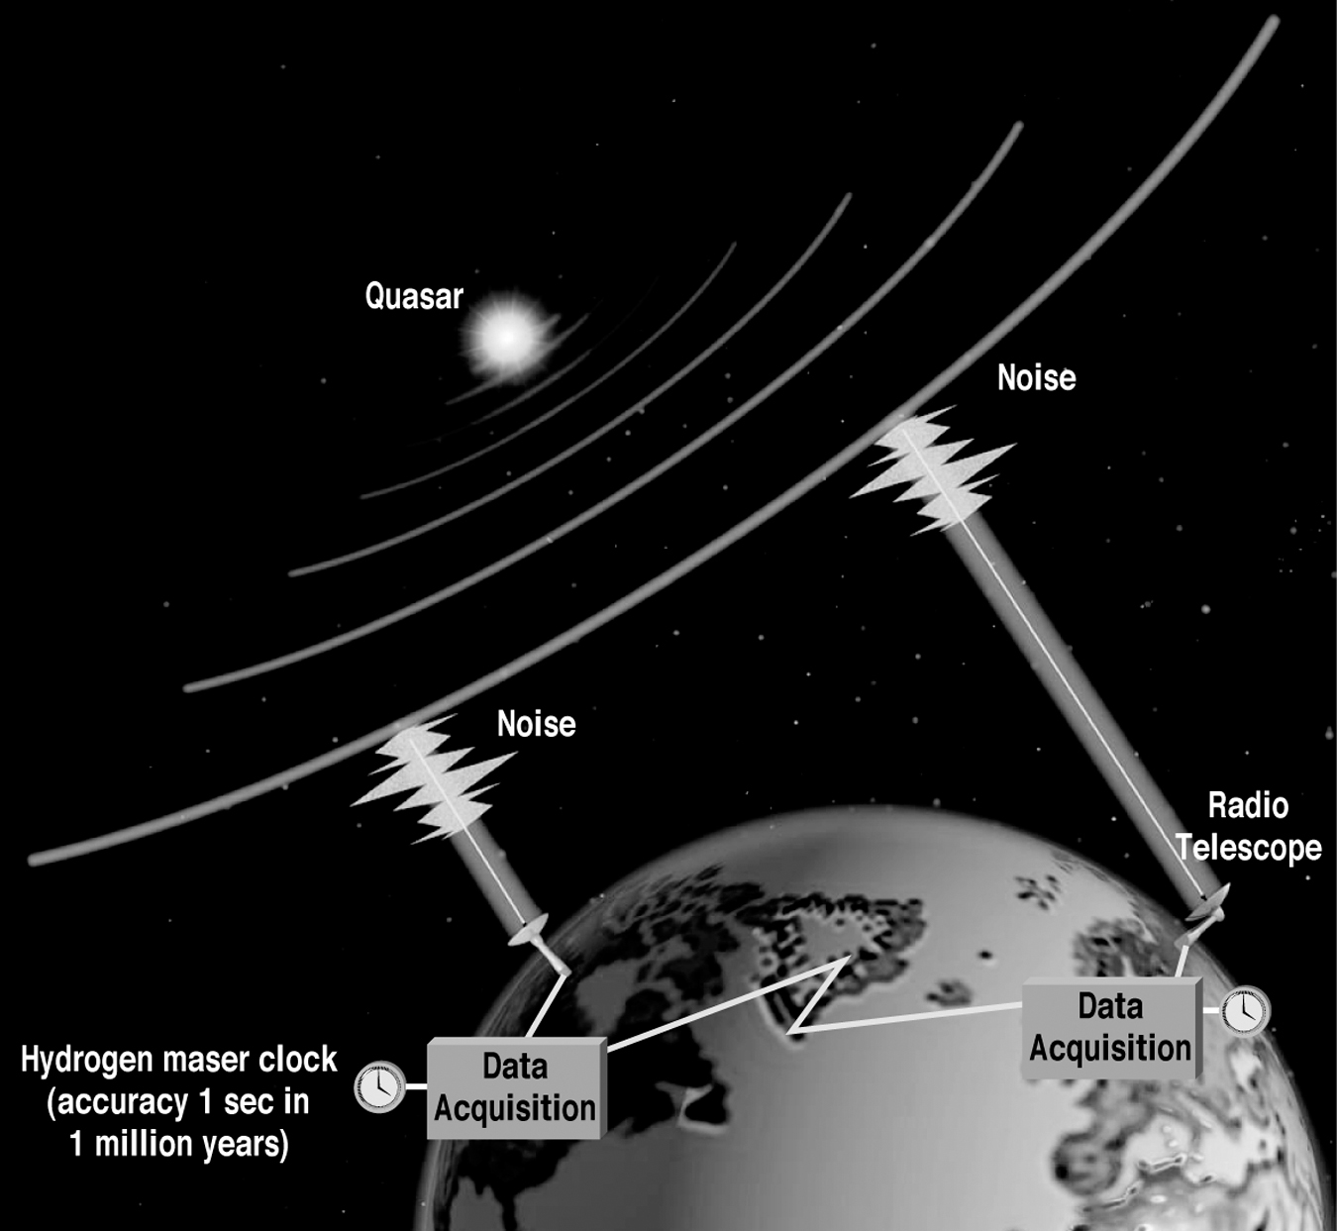
What is LBI or VLBI
LBI (Long Baseline Interferometry) or VLBI (Very Long Baseline Interferometry) is a radio (e.g., microwave-based) space geodetic technique that measures the time difference of arrivals (TDOAs) of signals from a radio source through cross correlation.
Recently radio telescopes in the European VLBI Network (EVN) have observed a repeating fast radio burst (FRB) in a spiral galaxy similar to the Milky Way.
This FRB is the closest to Earth ever localized and was found in a radically different environment to previous studies.
The discovery changes researchers' assumptions on the origins of these mysterious extragalactic events.
G. Xu (ed.), Sciences of Geodesy - II, DOI: 10.1007/978-3-642-28000-9_7, © Springer-Verlag Berlin Heidelberg 2013, by Harald Schuh and Johannes Böhm
Notes:
At this point in time, one of the greatest mysteries in astronomy is where short, dramatic bursts of radio light seen across the universLong Baseline Interferometry represents a microwave-based geodetic technique that utilizes the magnitudes and differing arrival times of signals in order to determine the form and location of its source.
The technique has existed for decades and has gradually improved by more advanced signal transferring, receiving, and processing technically--such as the internet--up to very recent times, in which its culminated degrees of technological advancement enabled the Event Horizon Telescope to fabricate the first detailed image of a black hole, earning the project the Breakthrough Prize in Fundamental Physics within the year 2020.
Following the aforementioned degree of progression, radio astronomy has shown major promise in expanding humanity's general understanding of the workings of the universe through an extension of our breadth of perception.
The aforementioned breakthroughs in astronomical and technological achievement surely brings forth a wave of excitement and enthusiasm within the general field of astrophysics research, as it enables a variety of possible pursuits of study. Upon the imaging of the supermassive black hole present within Messier 87, there will surely exist a degree of interest for the application of Long Baseline Interferometry in regard to the imaging of various other celestial formations or even other astronomical studies. However, such equipment necessary to utilize LBI techniques are often expensive--costing at least $270000 in components--and is thus limited to researchers that might lack necessary funding. An excessive degree of opportunity cost as well as lack of involved populace almost always serves as a hindrance to the general advancement of scientific research. Thus, our ultimate objective is to provide a cheaper, open source, and more easily accessible alternative to Long Baseline Interferometry technology; an ultra-low cost and portable LBI device for students and amateur astronomy researchers.
LBI is different from antenna array receiver technology, which uses more than one antenna at each receiver station. One challenge of antenna array receiver is the radio signals received by the antenna array can be highly correlated and suffer from similar channel condition. As such, it lacks important diversity gains.
e, known as fast radio bursts (FRBs), are originating from.

Slide 3

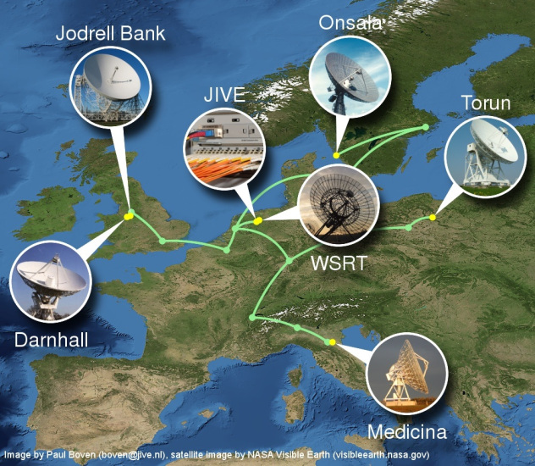
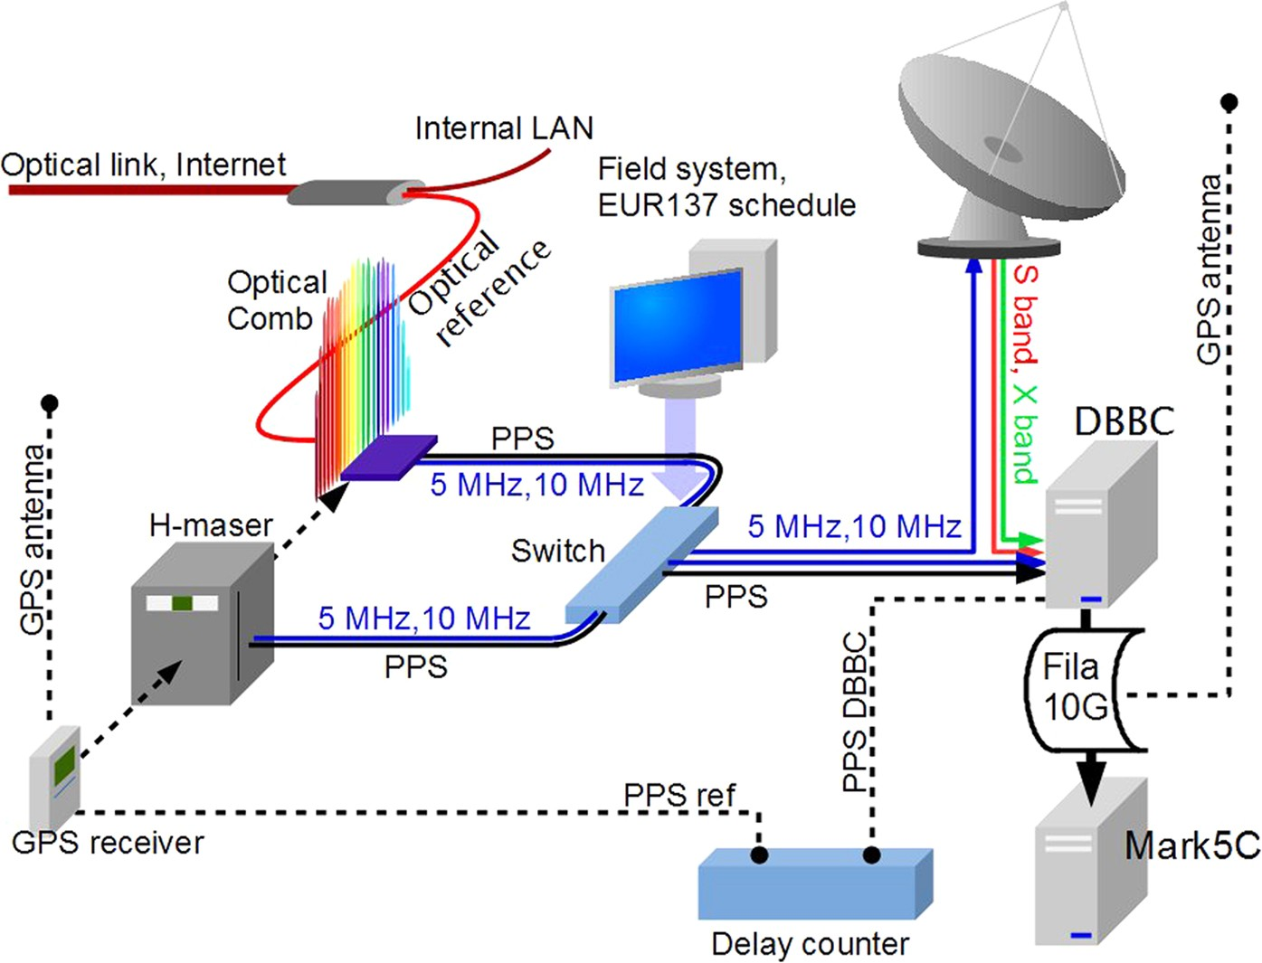
VLBI network is massive and expensive
Approximate Cost for Current VLBI Technology
Component | Cost
Digital BBC units (500 Hz) | $20,000 each
Data Storage units (1 Gb/s) | $16,000 each
Network Unit(10 sec) | $175,000
Power Supplies + Backplane + GPS clock | $20,000
Total | $270,000
Doeleman, Shep. “mmVLBI in the Future technical/experimental”. Haystack Observatory
Clivati, C., Ambrosini, R., Artz, T. et al. A VLBI experiment using a remote atomic clock via a coherent fibre link. Sci Rep 7, 40992 (2017).
Notes:
Our device will specifically be made utilizing off the shelf hardware components (Software-Defined Radio hardware, Raspberry Pi, portable batteries and computers), open source software (GNU radio and Realtek Software-Defined Radio), and open computing infrastructure (Berkeley Open Infrastructure for Network Computing). In the future, we will demonstrate its capability to fabricate imaging of distant cosmic radio sources as well as the tracking of satellites and spacecraft.

Slide 4
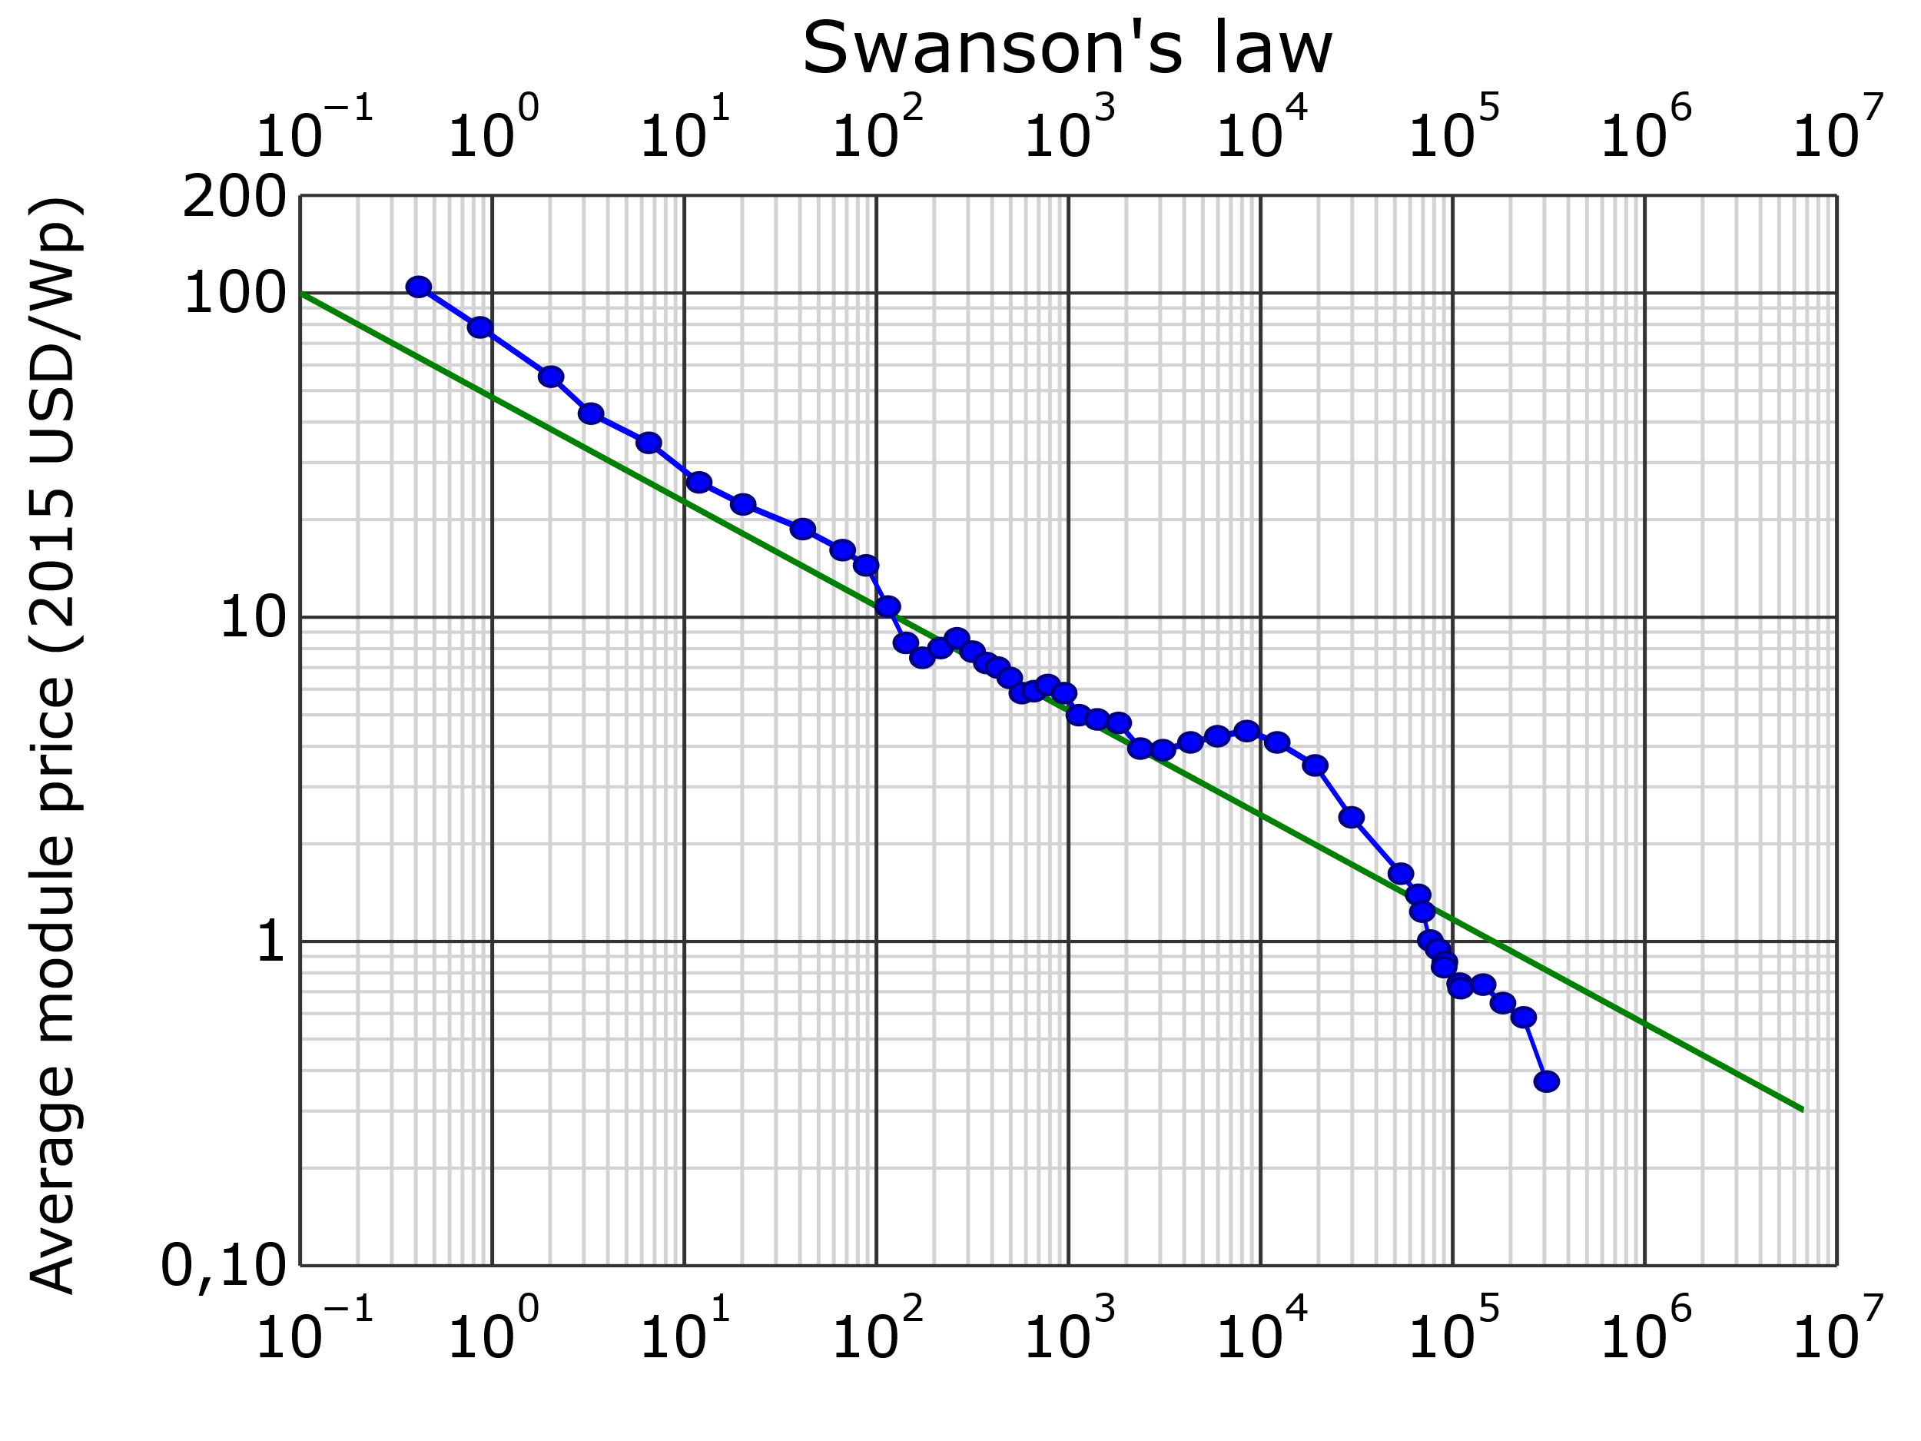
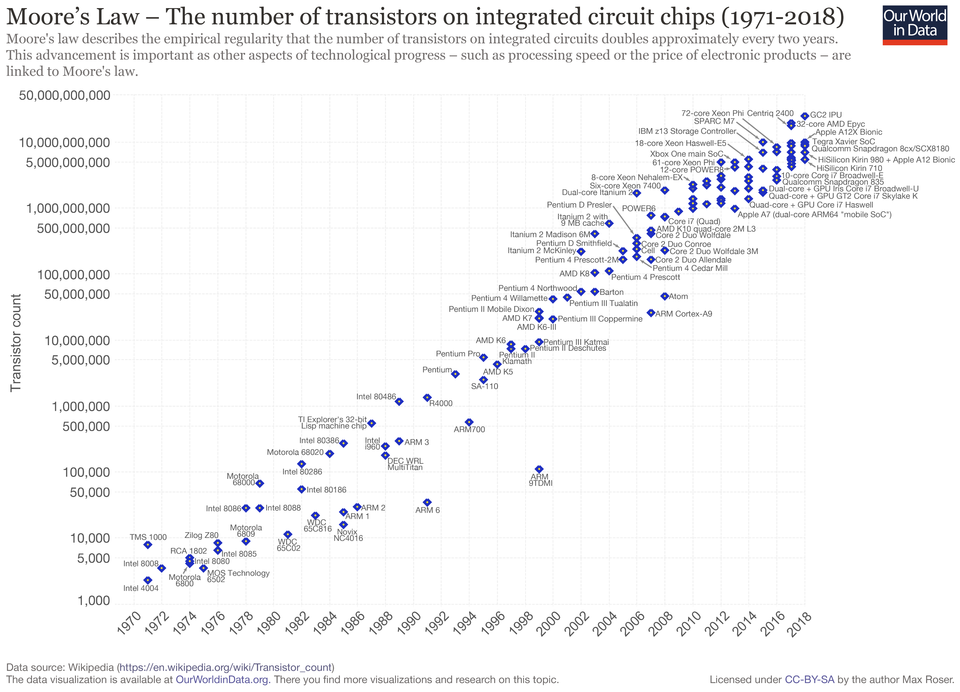
Can we make Ultra-Low Cost LBI for Most of US?
Current very long-baseline interferometry (VLBI) technology is highly customized and extremely expensive for researchers. However, they are good.
Is there any thing similar for students and amateurs?
Are Swanson’s law and Moore’s law also applicable to VLBI and LBI?
https://en.wikipedia.org/wiki/Swanson%27s_law
Approximate Cost for Proposed Homebrew LBI As An Example
Component | Cost
2x Software Defined Radio + Dipole Antennas | $60.00
Raspberry Pi | $46.07
Micro SD Memory Card | $8.90
Software-Defined Radio (e.g, RTL-SDR) | $24.00
Total | $139.97
By Max Roser - https://ourworldindata.org/uploads/2019/05/Transistor-Count-over-time-to-2018.png, CC BY-SA 4.0, https://commons.wikimedia.org/w/index.php?curid=79751151

Slide 5
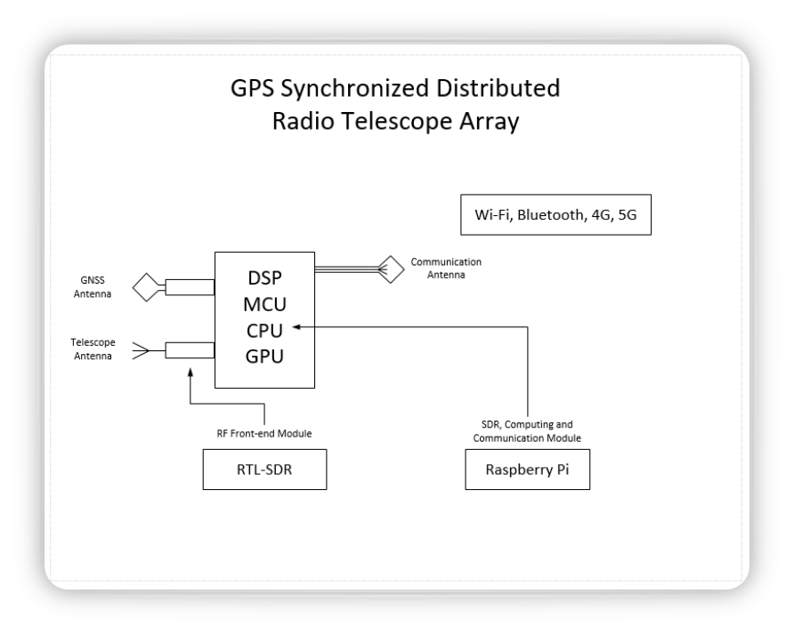
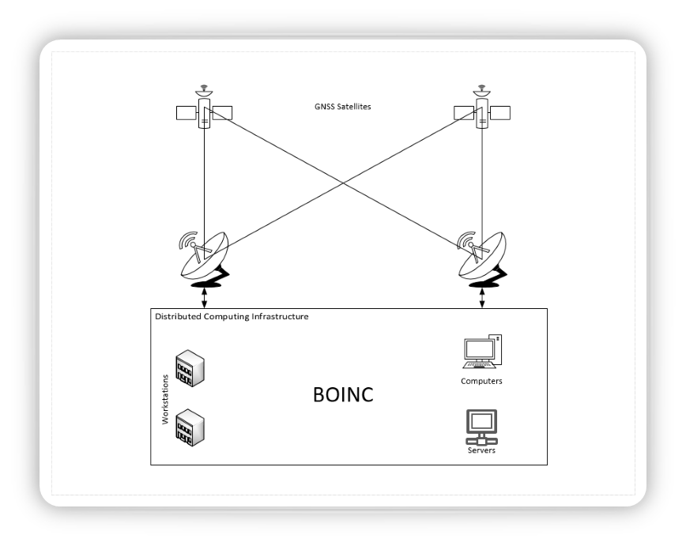
Our Homebrew LBI System

Slide 6
What STARGAZINGTech.ORG wants to achieve is
During the past summer, we started Stargazing Technologies, a non-profit organization, for developing ultra-low cost and portable LBI devices for students and amateur astronomy researchers from and with:
Off the shelf hardware. It will be made from SDR hardware, Raspberry Pi computer, portable battery and computers.
Open Source software. GNU radio, RTL-SDR
Open Computing Infrastructure. BONIC (Berkeley Open Infrastructure for Network Computing)
We will demonstrate the capability of imaging distant cosmic radio sources, satellites and spacecraft tracking.
We want to help promote the education and research cooperation between worldwide students and amateur astrophysicists.

Slide 7
solving the same hard engineering Problems, but at MUCH MUCH lower costs
The main problem is, how to receive weak radio signals?
The reception of weak radio signals is improved through interference, "coherent combining" the signals received by a distributed network of LBI station.
How to coherently combine the independently and individually received radio signals?
Because LBI stations are spatially distributed and each equipped with their own local clock references (LO).
In order to successfully coherently combining the signals, we have to estimate the relative timing offset or the composite phase difference between the signal samples generated by the LBI stations.
The relative timing offset(s) are estimated from the observed time difference of arrival (OTDOA) of common GPS signals
Besides GPS signals, other common reference signals will be also considered in the future

Slide 8
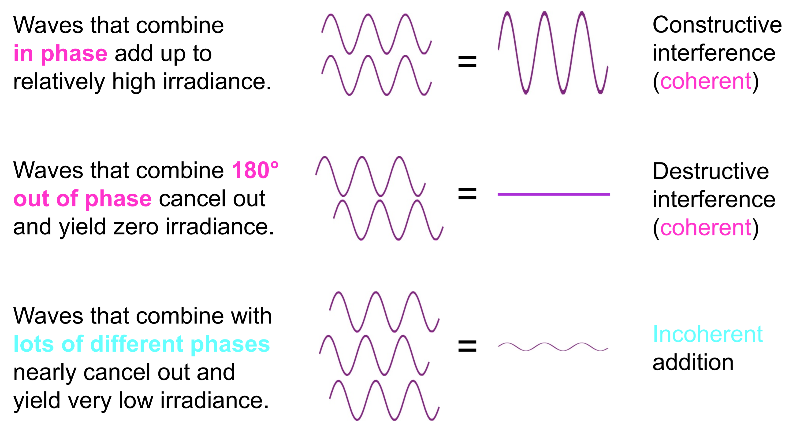
Interference – Coherent Superposition
Rick Trebino, Interference, http://www.physics.gatech.edu/frog/lectures, Georgia Tech

Slide 9
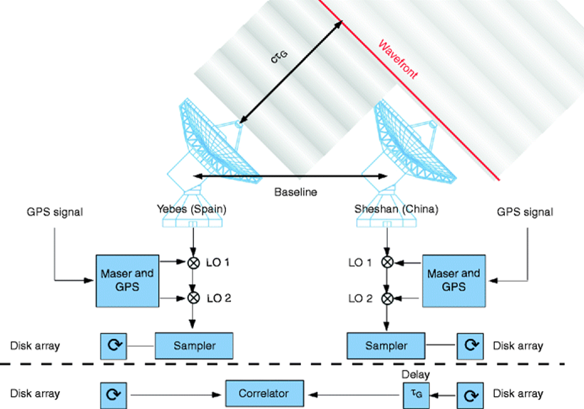
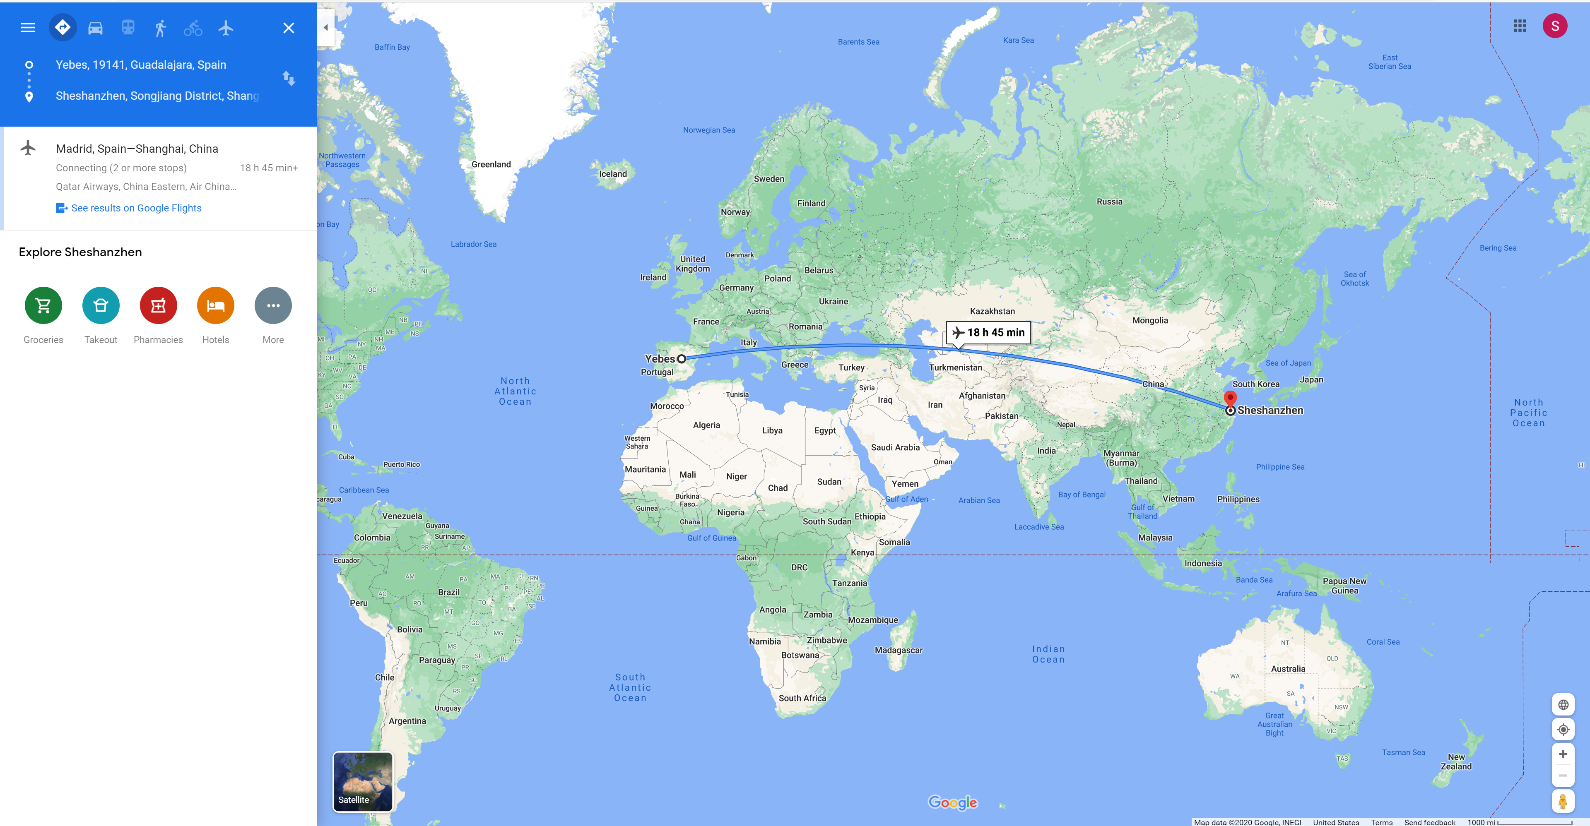
How to Combine the Signals Geographically Distributed?
Helmut Wiesemeyer and Axel Nothnagel, Very Long Baseline Interferometry, https://doi.org/10.1007/978-90-481-8702-7
The geographical distance between Yebes, Spain and Sheshan, China is more than 10,000 kilometers.

Slide 10
The Key is the timing synchronization between stations Through GPS
In our design, we are using an independent radio reference signal source (e.g., GPS) for the timing synchronization between spatially distributed stations.
As such, there are two major timing error sources:
System Error, due to the uncorrelation between reference signals and the target signals.
Synchronization Error, e.g., the GPS synchronization error
These two error sources will be analyzed and further compensate during interference and coherent combining stage.

Slide 11
Major Timing Errors(1/2): System Error
In our current Phase I prototyping, our design doesn’t consider the radio signal propagation distamce difference between two LBI stations
This limits the spatial distribution distance between two LBI stations.
On earth, the earth diameter is ~12,765 km. As such, the maximum propagation delay between two LBI station is 12,765 km / 300,000 kmps = ~42550 us.
In our initial prototyping, we are using low cost RTL-SDR receiver, which can operate at 3.0MHz sampling clock, which generates one sample every 0.33 us.
As such, the recommended maximum LBI station distance of our initial prototyping is several 100 meters.
In our next generation prototyping, the propagation delay will be taken accounted into design.

Slide 12
Major Timing Errors(2/2): Synchronization Error
Error Sources | Absolute GPS |  | Differential GPS
 | P Code | L1 C/A Code | P Code | C/A Code
Satellite Clock & Ephemeris Errors | 0.013 us | 0.013 us | 0 | 0
Ionospheric Delay | 0.01033 us | 0.03 us | 0 | 0
Tropospheric Delay | 0.006667 us | 0.006667 us | 0.0005 us | 0.0005 us
Receiver Noise and Resolution | 0.003667 us | 0.037 us | 0.003667 us | 0.037 us
Multipath | 0.004 us | 0.04 us | 0.004 us | 0.04 us
Other |  |  | 0 | 0
*Selective Availability |  | 0.1 us | 0 | 0
Total System Error 1σ | 0.01867 us | 0.1187 us | 0.004333 us | 0.05333 us
Position Error PDOP = 2.92 | 16.3 m | 104 m | 3.8 m | 48 m
Shu Wang, et al., “Location Based Services for Mobiles: Technologies and Standards,” IEEE ICC 2008, Beijing, China, 2008
R. M. Kalafus, et al., “Differential operation of Navstar GPS”, Navigation Vol. 30, No. 3, 1983

Slide 13
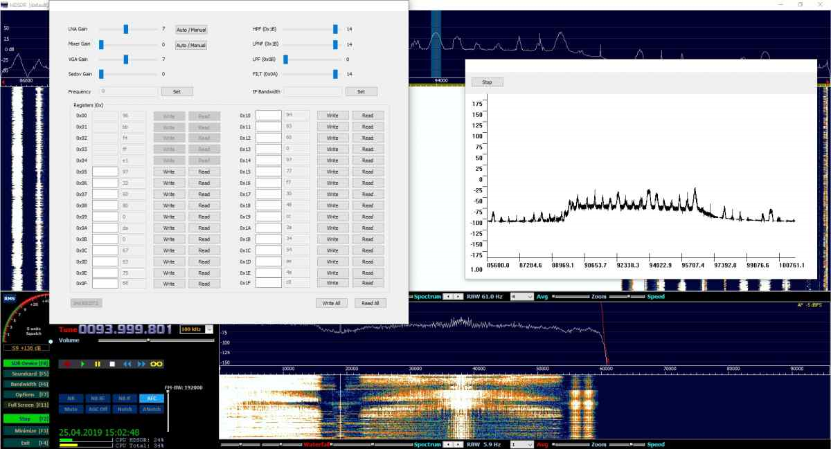
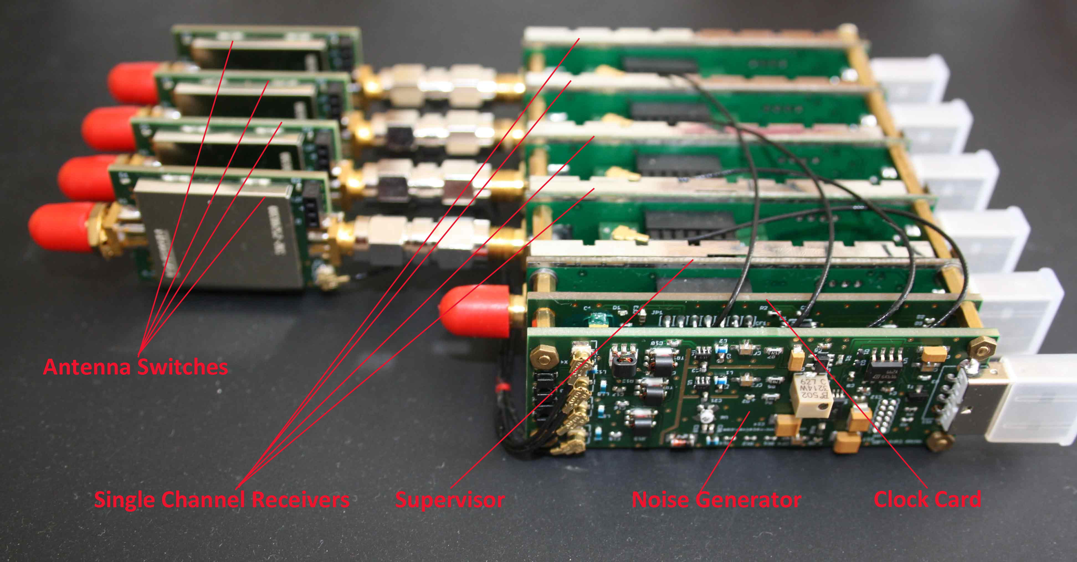
Low-Cost RTL-SDR Based Coherent-Receiver
Single-board multi-tuner receivers
Frequency Range: 24 MHz – 1.7 GHz
ADC Sample Rate: 25 MSPS
up to 8 MHz spectrum (10 MHz on request with an alternative tuner) per tuner
Bit Depth: 8 bits – 4 Tuners on board; 12 bits-16bits – 2 Tuners on board
All channels on the board are sampled synchronously and have common clock (2 or 4 synchronous channels). External synchronization is necessary only for the phase calibration. Multiple boards can be chained together with a common clock and an additional I/Q-synchronization
https://coherent-receiver.com/products/coherent-receivers/1-supervisory-and-4-coherent-channels

Slide 14
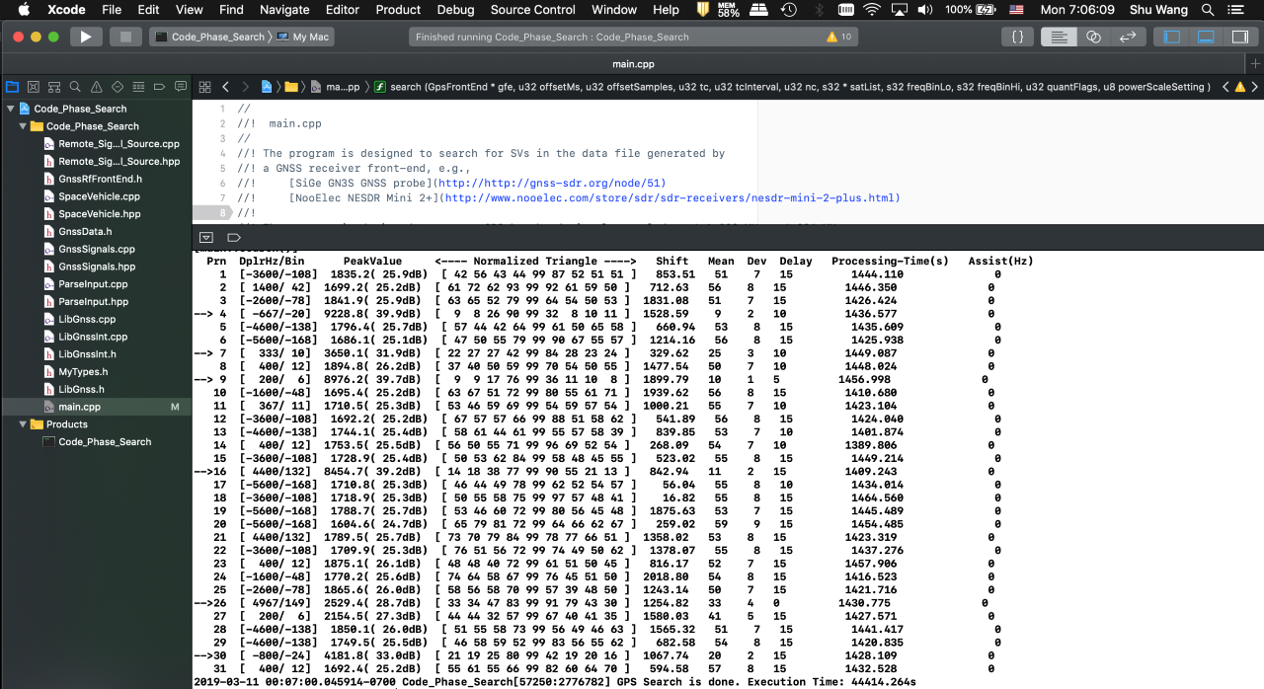
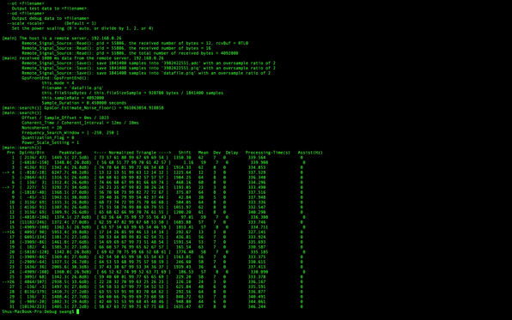
Some Preliminary Results

Slide 15
Phased Development Plan
​ | Phase I​ | Phase II​ | Phase III​
Radio Frequency up to 1.7GHz​ | ✓​ | ✓​ | ✓​
GPS-Base Synchronization​ | ✓​ | ✓​ | ✓​
Distributed Signal Processing in BOINC​ | ✓​ | ✓​ | ✓​
Battery Power Supply​ | ✓​ | ✓​ | ✓​
Radio Frequency up to 6GHz​ | ​ | ✓​ | ✓​
Distributed File Synchronization​ | ​ | ✓​ | ✓​
Wi-Fi Mesh Network​ | ​ | ✓​ | ✓​
Solar Panel Power Supply​ | ​ | ​ | ✓​
Data Integrity Guard​ | ​ | ​ | ✓​
GPGPU Processing Acceleration​ | ​ | ​ | ✓​
Airborne Deployment Capable​ | ​ | ​ | ✓​
​ | UHF Antenna​ $12~$90​ | GNSS Antenna​ $8~$160​ | RTL-SDR​ $22~$30​ | Raspberry Pi 4​ $60~$100​ | MicroSD Card​ $20​ | Lithium PolymerBattery​ $27​
Telescope Antenna​ | ✓​ | ​ | ​ | ​ | ​ | ​
GNSS Antenna​ | ​ | ✓​ | ​ | ​ | ​ | ​
Communication Antenna​ | ​ | ​ | ​ | ✓​ | ​ | ​
Radio Telescope RF Front End​ | ​ | ​ | ✓​ | ​ | ​ | ​
GNSS RF Front-End​ | ​ | ​ | ✓​ | ​ | ​ | ​
Signal Processing, Control and Communication Module​ | ​ | ​ | ​ | ✓​ | ​ | ​
Data Storage​ | ​ | ​ | ​ | ​ | ✓​ | ​
Power Supply​ | ​ | ​ | ​ | ​ | ​ | ✓​

Slide 16

Thank you so much for your time!

